Slide 1

CCTV footage person attribute extraction system
Vivekananda College of Engineering & Technology
[A Unit of Vivekananda Vidyavardhaka Sangha, Puttur ®]
Affiliated to Visvesvaraya Technological University
Approved by AICTE New Delhi & Govt of Karnataka
Department : Computer Science & Engineering (Data Science)
Guide : Prof. NAGARAJA N S
Team Members | USN
Naik Jitesh Mahabaleshwar | 4VP22CD032
Rahul Umesh Durgekar | 4VP22CD039
Sachin Rathod | 4VP22CD044
Shreyas | 4VP22CD052

Slide 2
Contents
Introduction
Problem statement
Existing solution
Proposed solution
System requirements
Methodology
Conclusion
References

Slide 3
Introduction
In today’s security-driven world, manually analyzing CCTV footage to extract attributes like height, age, clothing color, or body tone is inefficient and error-prone.
Our AI-Powered Attribute Extraction System addresses this by automating the process: leveraging YOLO/Faster R-CNN for real-time person detection and deep learning models to identify physical appearance-based traits.
By generating actionable profiles and insights through dashboards, the system enhances decision-making in security, forensic investigations, and crowd management, transforming raw surveillance data into strategic intelligence.

Slide 4
Problem Statement
Manual extraction of individual attributes (height, age, clothing) from CCTV footage is slow and error-prone.
Current systems lack real-time automation, delaying critical security responses.
This project develops an AI-driven system to automate precise attribute extraction, enhancing decision speed and accuracy in security, forensics, and crowd management..

Slide 5
Existing Solution
Manual CCTV Monitoring: Time-consuming and error-prone human analysis.
Basic Motion Detection: Triggers alerts but lacks attribute extraction.
Facial Recognition: Limited to face ID, requires high-resolution images.
Research Models: Focus on single attributes (e.g., age/clothing) without real-time integration.
Commercial Tools: Costly, limited to basic analytics (e.g., color detection).

Slide 6
Proposed Solution
AI-Driven System: Automates CCTV analysis using YOLO(detection) + ByteTrack (tracking) for real-time person identification.
Multi-Attribute Extraction: Height, weight, age, clothing color, body tone, and gait using MediaPipe, EfficientNet, and OpenCV.
Tools: OpenCV (preprocessing), PyTorch/TensorFlow (models), Streamlit (dashboard), Twilio/Slack (alerts).
Real-Time Output: Dashboards with profiles + instant alerts for anomalies (e.g., loitering).

Slide 7
System Requirements
Hardware:
Computer: A modern laptop/desktop (i5/Ryzen 5 or higher).
RAM: 8GB (minimum), 16GB (recommended).
Storage: 256GB or above (for videos and software).
Software:
Operating System: Windows 10/11.
Python: Installed with libraries like OpenCV, PyTorch, and MediaPipe.
Streamlit.

Slide 8
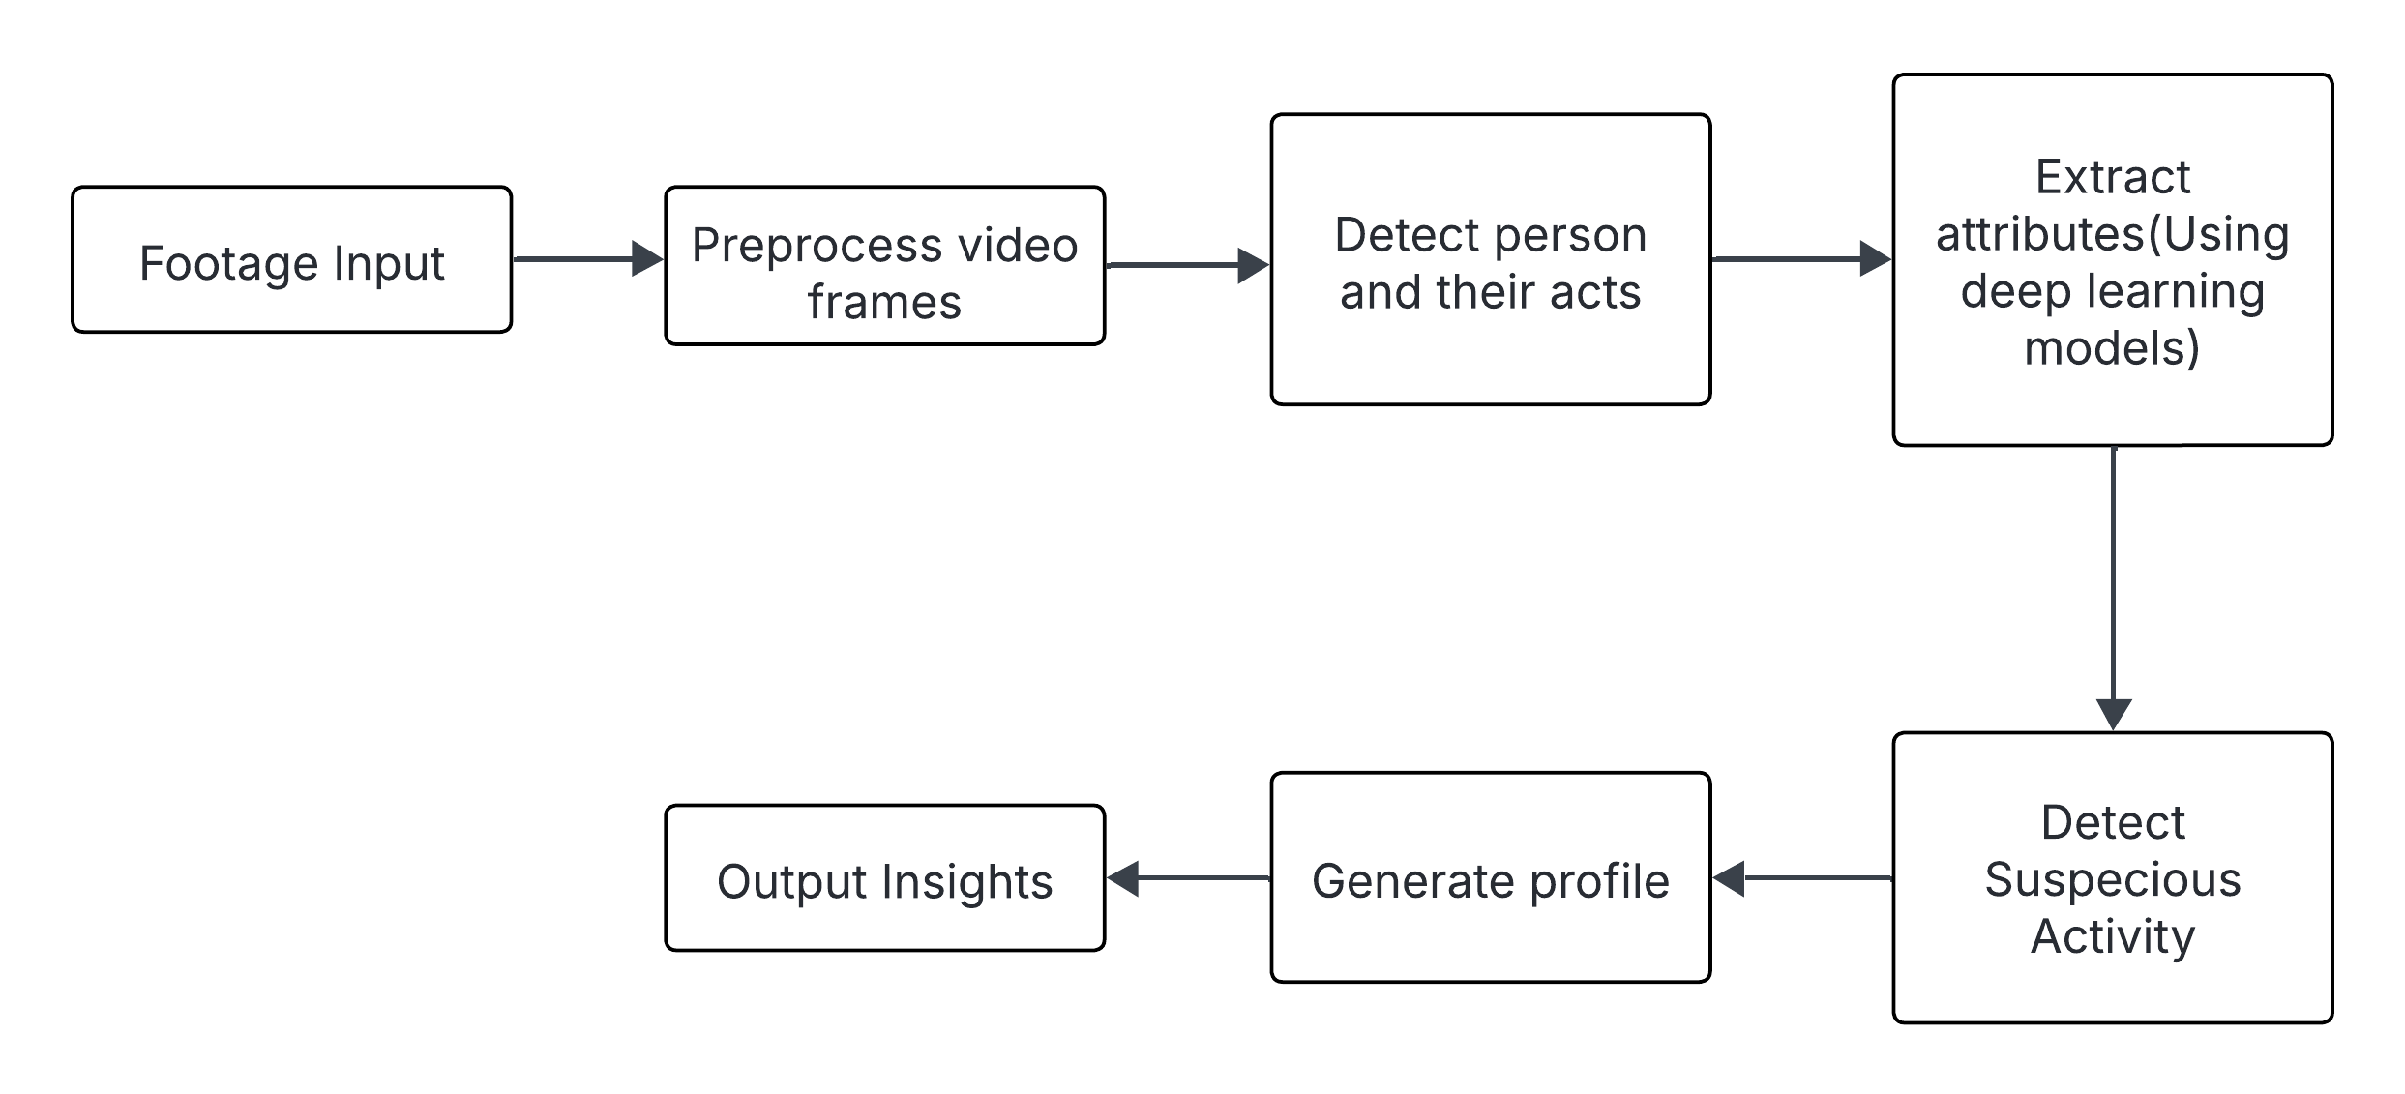
Methodology
Extract Attributes ( Using deep learning models )
Preprocess Video Frames
Detect Person and their acts
Footage Input
Detect Suspicious Activity
Output Insights
Generate Profile

Slide 9
Conclusion
This project addresses the critical inefficiencies in manual CCTV analysis by introducing an AI-driven attribute extraction system that automates the identification of individual traits (height, age, clothing color, body tone) in real time. By integrating advanced tools like YOLOv9 for detection, ByteTrack for tracking, and EfficientNet/MediaPipe for attribute classification, the system transforms raw surveillance footage into actionable security insights.

Slide 10
References
Mukto, Md Muktadir, Mahamudul Hasan, Md Maiyaz Al Mahmud, Ikramul Haque, Md Ahsan Ahmed, Taskeed Jabid, Md Sawkat Ali, Mohammad Rifat Ahmmad Rashid, Mohammad Manzurul Islam, and Maheen Islam. "Design of a real-time crime monitoring system using deep learning techniques." Intelligent Systems with Applications 21 (2024): 200311.
Taha, Kamal, Paul D. Yoo, Yousof Al-Hammadi, Sami Muhaidat, and Chan Yeob Yeun. "Learning a deep-feature clustering model for gait-based individual identification." Computers & Security 136 (2024): 103559.

